Slide 1
Teaching with AI: From Passive Users to Critical Partners
An Innovative Assessment for a GenAI-Driven World Dr. Michael Borck

Slide 2
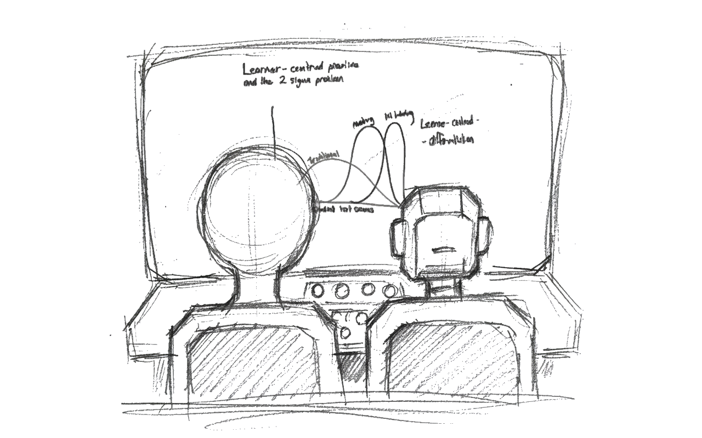
Welcome

Slide 3

The Context: An Industry in Motion

Slide 4
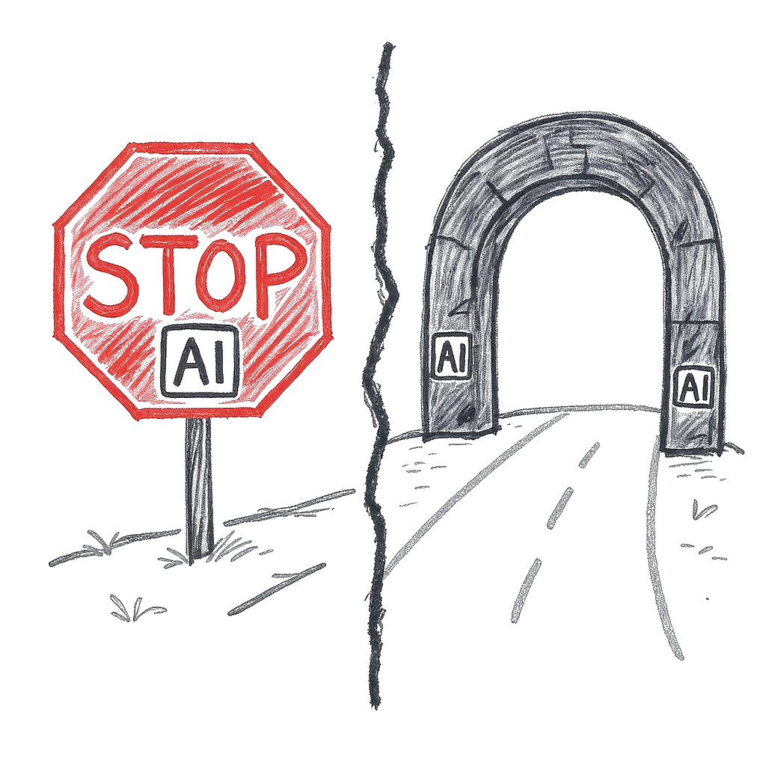
The Challenge: Assessing with AI

Slide 5
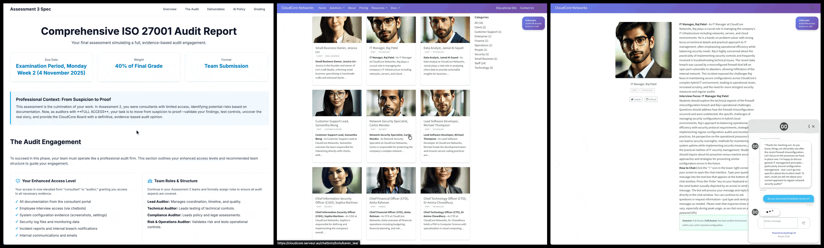
The Assessment: The ‘CloudCore’ Audit

Slide 6
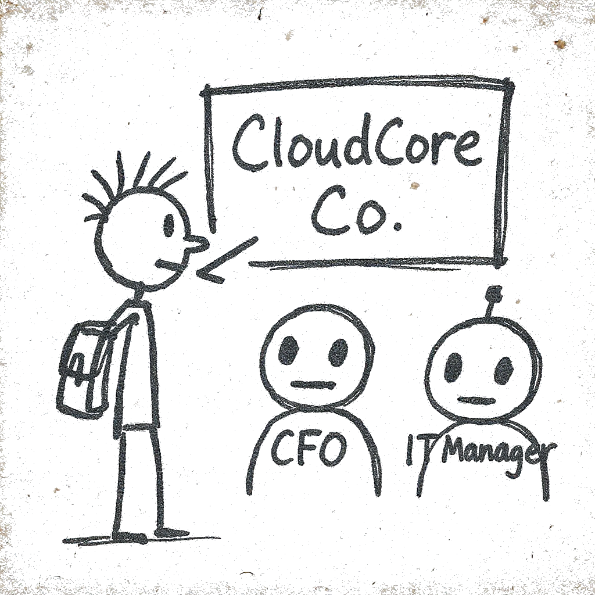
Innovation 1: AI as the “Client”

Slide 7
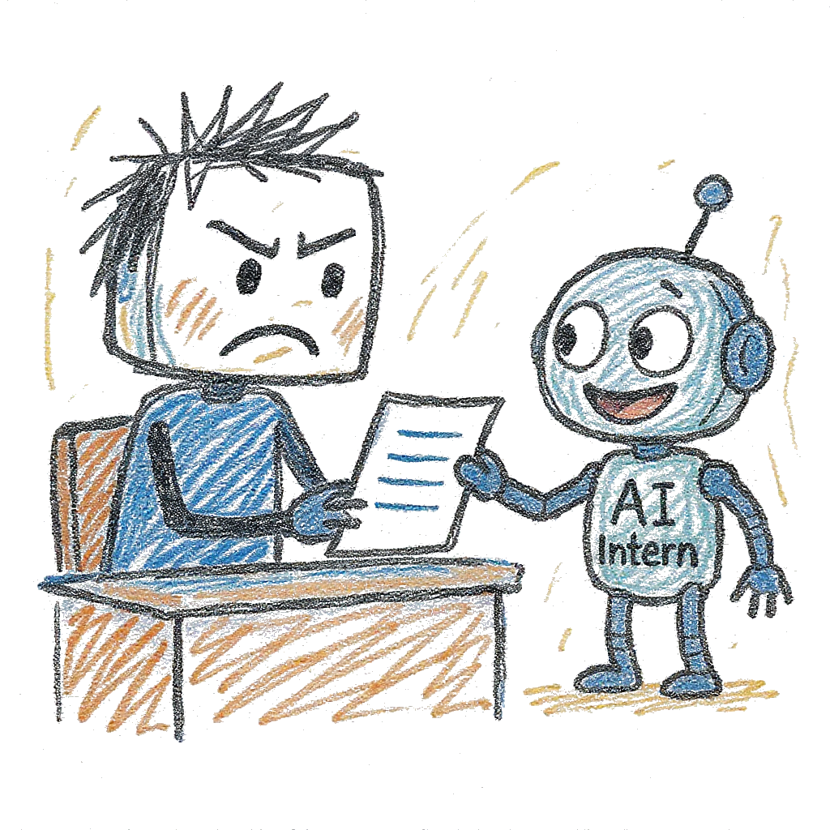
Innovation 2: AI as the “Intern”

Slide 8
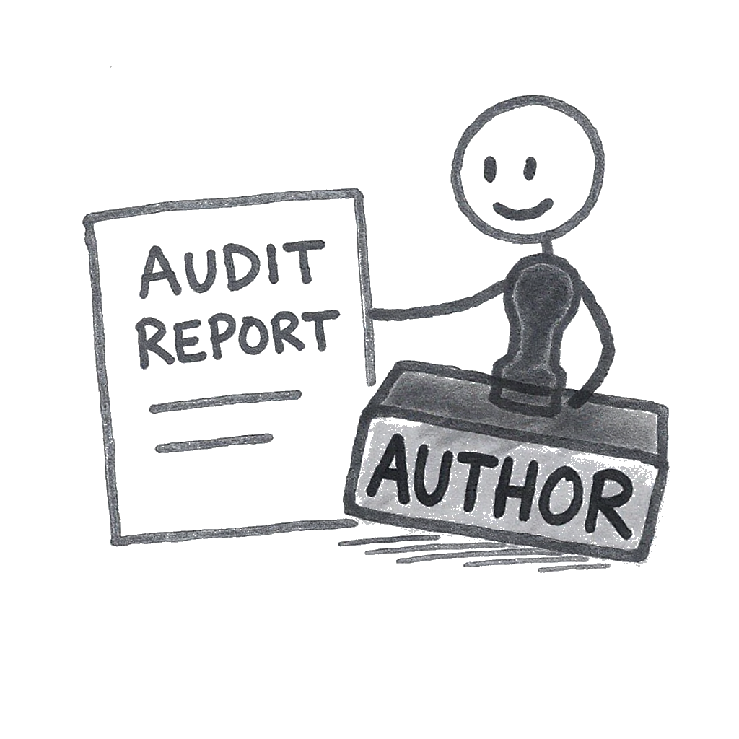
The Student as “Author”

Slide 9
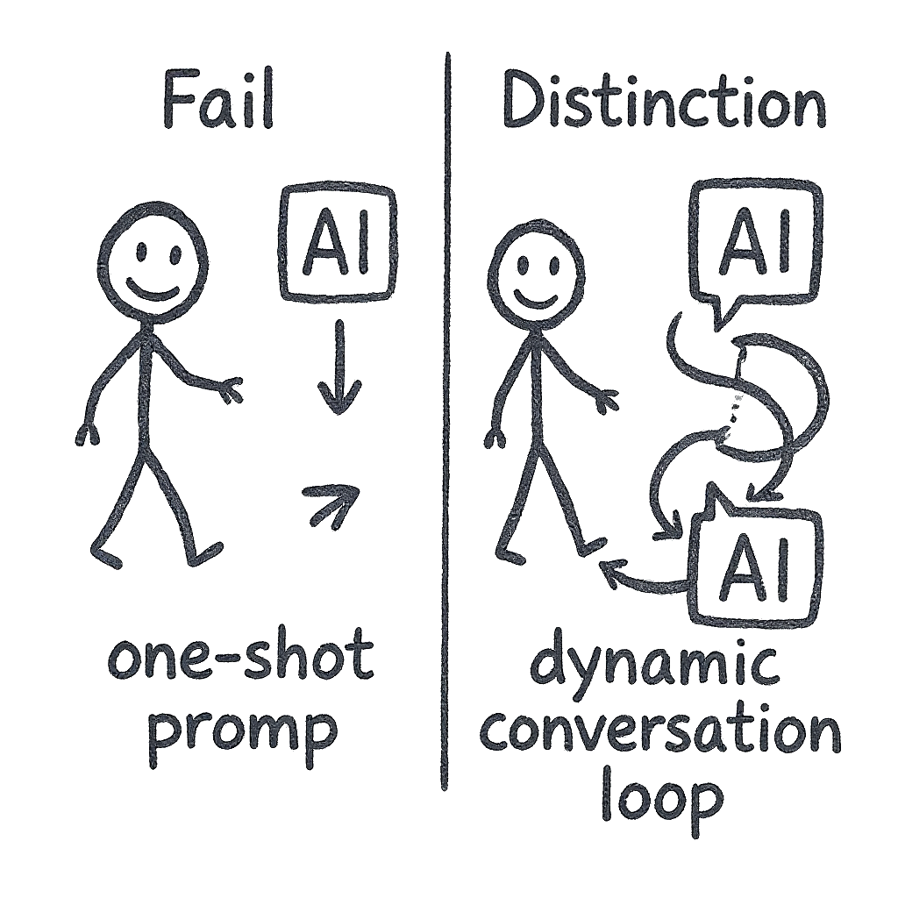
Pedagogy: “Thinking with AI”

Slide 10

Design & Authenticity

Slide 11
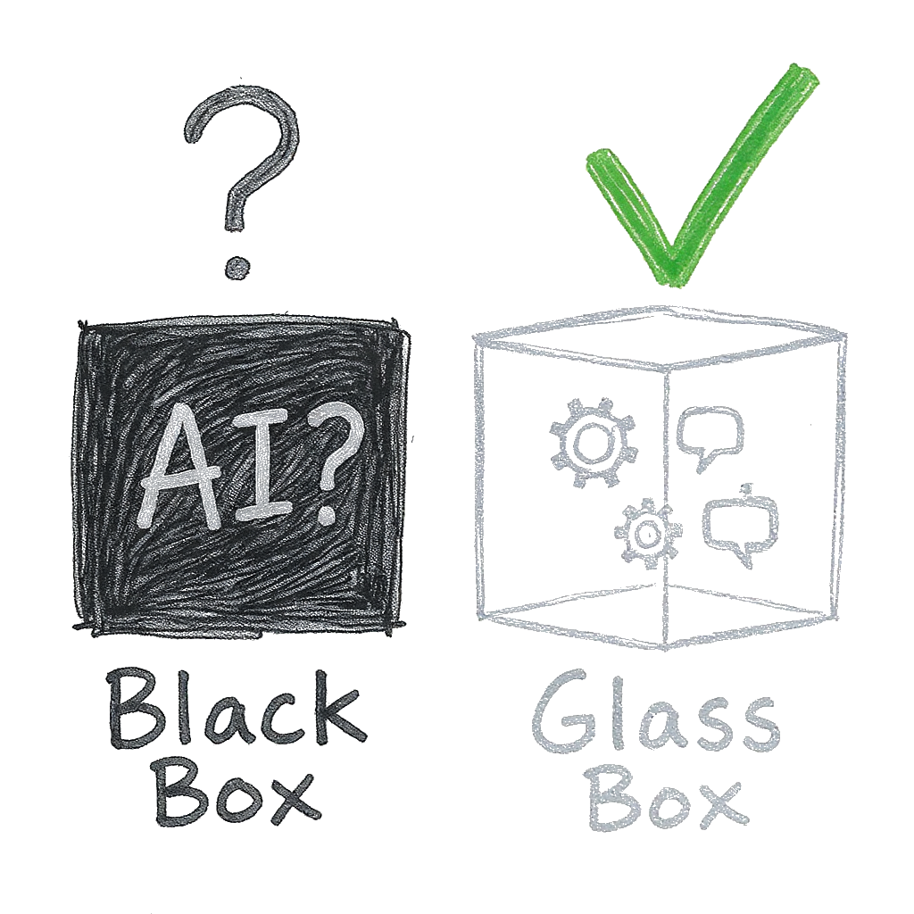
Academic Integrity as Transparency

Slide 12
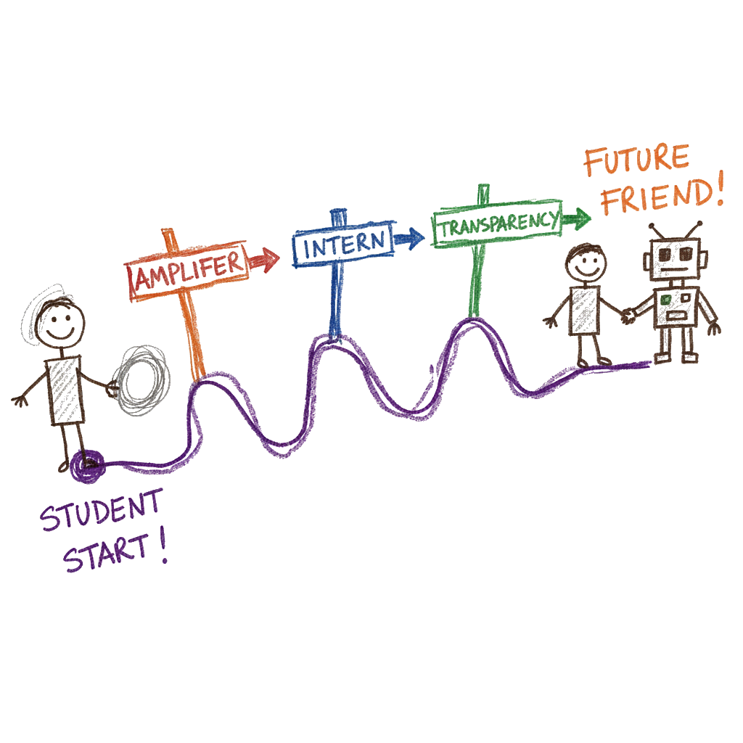
Key Takeaways

Slide 13

Thank You

Slide 14
Dr. Michael Borck michael.borck@curtin.edu.au

